Slide 1


BASRAH UNIVERSITY
Faculty of Education for Pure Sciences
Biology Department
2025- 2026
Lecture 2
Kingdom Protista
Presented By: Prof. Dr. Sabeeh H. AL-Mayah

Slide 2
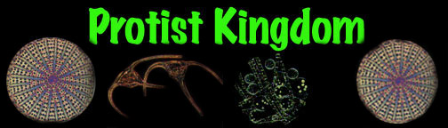

Kingdom Protista
Protists are unicellular organisms that have a nucleus.

Slide 3
KINGDOM PROTISTA
Conglomerate of organisms which do not fit into other 4 Kingdoms
Moneran (bacteria), Animalia, Plantae, Fungi
Much more complicated than Monerans
They represent the intermediate step in the evolution of the other three kingdoms
Protozoan is the Greek word for “first animal”
Contains about 65,000 species

Slide 4
KINGDOM PROTISTA
Made up of a complex eukaryotic cell (unicellular) or cells (multicellular)
Prefix uni
One (single)
Prefix multi
More than one (many)
Kingdom has organisms that demonstrate both animal and plant-like characteristics
Some members make their own food (________)
autotrophs
heterotrophs
Some ingest food from outside (____________)

Slide 5
KINGDOM PROTISTA
Organisms separated based on feeding behaviors
Autotrophs
Heterotrophs
green algae brown algae red algae diatoms dinoflagellates euglenoids
amoeboids ciliates zooflagellates sporozoans
Notes:
http://faculty.clintoncc.suny.edu/faculty/Michael.Gregory/files/Bio%20102/Bio%20102%20lectures/Protists/protists.htm (good pics also)

Slide 6
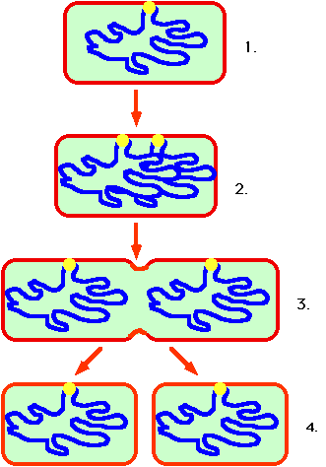
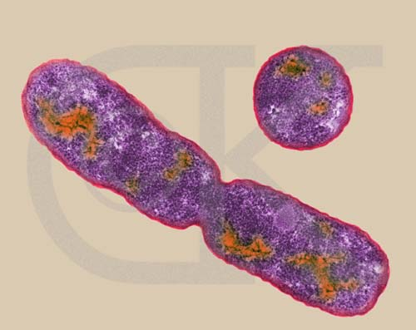
All Protozoa can reproduce asexually
One “parent” for reproduction
Called binary fission
During binary fission, one protozoan cell divides into two identical individuals.

Slide 7
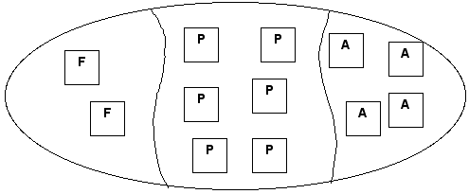
KINGDOM PROTISTA
water
land
Inhabit aquatic (______) areas and terrestrial (_____) areas
Protists are classified into 12 Phyla which can be placed into 3 main groups
plant-like
fungus-like
animal-like

Slide 8
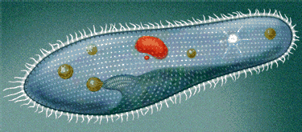
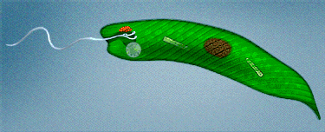
Animal-like Protists
classified by the 4 ways they move:
1) Cilia -
tiny beating hair-like structures
Coordinated movement between individual cilia
2) Flagellum(a) -
whip-like tail(s)
Back and forth wave motion

Slide 9
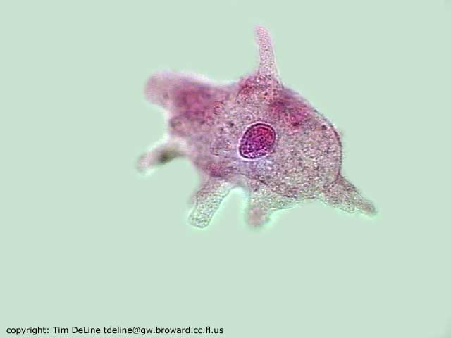
Animal-like Protists
projection of cytoplasm that sticks out like a foot (“false foot”)
3) Pseudopodia -
4) Sessile -
movement
No locomotion (_________)
Notes:
http://www.microscopy-uk.org.uk/mag/indexmag.html?http://www.microscopy-uk.org.uk/mag/wimsmall/flagdr.html http://micro.magnet.fsu.edu/moviegallery/pondscum/protozoa/amoeba/index.html

Slide 10
Phylum: Protozoa
Sub Ph.:
Plasmodroma
Sub ph.:
Ciliophora
Cl.: Sarcodinea
Cl.: Flagelleta
Class: Ciliatea
Cl.: Sporozoa

Slide 11
Classification of the Protozoa
Based on their ability and method of movement, three major groups of protozoa are recognized and often given the status of phylum:
Phylum Sarcomastigophora
Phylum Apicomplexa
Phylum Ciliophora
Phylum Sarcomastigophora
The largest protozoan phylum and has the following unifying characters:
Unicellular or colonial
Locomotion by flagella, pseudopodia or both
Autotrophic (self-nourishing), saprozoic (living in decaying organic matter), or heterotrophic (obtains energy from organic compounds)
Single type of nucleus
Usually reproduce asexually. There is no spore formation

Slide 12
Phylum Sarcomastigophora contd:
Phylum Sarcomastigophora is further divided into two subphyla:
Subphylum Mastigophora
Subphylum Sarcodina
Subphylum Mastigophora
Members of this subphylum use flagella for locomotion
They may be autotrophic, heterotrophic, or both; usually reproduce asexually by fission.
Two classes fall under this subphylum:
Class Phytomastigophorea
Class Zoomastigophorea

Slide 13
Class Phytomastigophorea
Members in this class possess chlorophyll and one or two flagella.
They produce a large portion of the food in marine food webs .
Much of the oxygen used in aquatic habitats comes from photosynthesis by these marine organisms.
Dinoflagellates, Euglena and Volvox are typical members of this class

Slide 14
Euglena as an animal
Euglena is studied as an animal as well as plant . It is more animal than a plant because of the following reasons.
1- Absence of a cellulose cell-wall overlying the plasma membrane . 2- Presence of centrioles forming the blepharoplasts or
kinetosomes .
3- Reserve food is paramylon which is not a true starch .
4- Presence of paraflageller body, a sensory (photoreceptive)
organelle.
5- Moves from place to place like animal.
6- Pinocytosis and probably holozoic nutrition takes place .

Slide 15
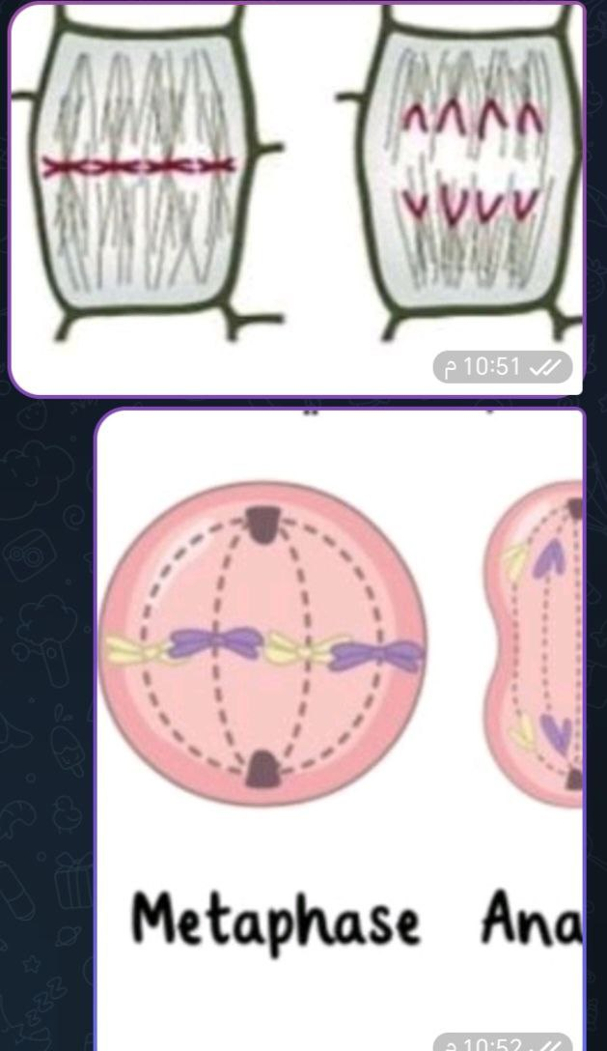

Slide 16
Euglena
Single-celled Protist that live in fresh water.
Captures and releases energy- producers (make their own food) and heterotrophs (gets food by eating other things)
Some contain chlorophyll
Eyespot helps them sense light. Can be autotrophic ( produces their own food).
Waste-Contractile vacuole holds excess water and removes it from the cell.
Movement. Flagella

Slide 18
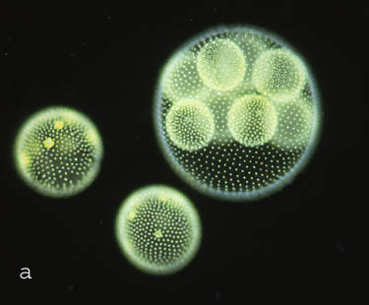
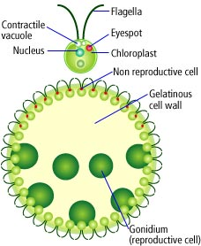
VOLVOX
Found in ponds, ditches, and puddles.
Composed of a colony of tiny flagellate cells. (more than 50,000 cells)
Often times called algae.
eyespots to help sense light.
Movement- Many flagella help move it.

Slide 19


Slide 20
Thank You!

